Slide 1


Google Gemini:
LLMs Unveiled
Team:
Manthan Varma: 712352045
Pratik Dassani: 712352031
Dhruv Malge: 712352024

Slide 2
Table of contents
01
02
Introduction
What are LLMs
03
04
05
Gemini
Applications
Challenges
Overview of Google Gemini project
Introduction to Large Language Models (LLMs)
Explanation of the architecture of Large Language Models
06
Conclusion
Training methodologies employed in Google Gemini
Use cases and real-world
applications of LLMs
Impact on natural language
understanding
Future trajectory of LLMs and their implications
Google's approach to responsible AI in the context of Gemini

Slide 3
Introduction
Today, we're diving into the exciting world of Google Gemini, a project that's redefining the way we interact with artificial intelligence. At its core, Google Gemini harnesses the power of Large Language Models (LLMs), pushing the boundaries of what machines can understand and generate in human language. In the next few minutes, we'll explore what makes Google Gemini and LLMs so groundbreaking and the impact they're having on our digital landscape. Let's uncover the magic behind "Google Gemini: LLMs Unveiled."

Slide 4
What are LLMs?
02
Let’s discuss what actually are LLMs

Slide 5


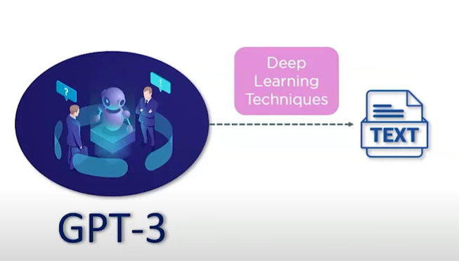
Large Language Models are basically very advanced artificial intelligence systems that can process and Generate Massive amounts of Data
They are designed to learn from and understand Natural Human Language (NLU).
It can be used to perform a wide range of language related tasks such as:
Translation
Speech Recognition
Automatic Summary Generation
LLMs have the ability to learn from vast amounts of data to generate highly accurate and realistic responses.
Uses Self Attention Mechanism
Analyze relationship between tokens in a text. It enables them to capture contextual information and generate coherent responses

Slide 6
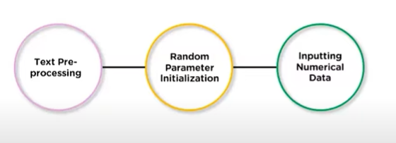
How LLMs are trained?
Large Language Models (LLMs) typically undergo through a number of steps to be trained in a proper accurate way.
1. Text Pre-processing:
The textual data is transformed into a numerical representation that can be effectively processed by the model. May involve techniques like tokenization, encoding and creating input sequences
2. Random Parameter Initialization:
The model’s parameters are initialized randomly before the training process begins
3. Inputting Numerical Data:
The numerical representation of text data is fed into the model for processing.
Transformer allows it to capture contextual relationship between the words and tokens in the text.

Slide 7
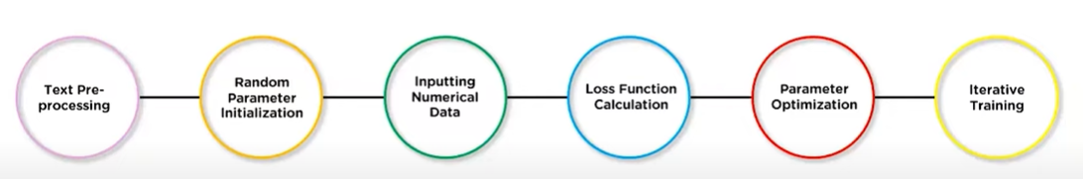
4. Loss Function Calculation
Loss function is employed to measure the discrepancy between the model’s predictions and the actual next word or token in a sentence. Aims to minimize this loss during training.
5. Parameter Optimization:
The model’s parameters are adjusted through optimization techniques such as gradient descent to reduce the loss.
This involves calculating radians and updating the parameters accordingly gradually improving the model’s performance
6. Iterative Training:
The training process is repeated over multiple iterations or stop until the model’s outputs achieve a satisfactory level of accuracy on the given task or dataset.
By following this training process
Large language model learn to
Capture linguistic patterns, understand
Context and generate coherent responses
[1]

Slide 8
03
Gemini
Let’s discuss about Gemini by Google

Slide 9
What is Gemini?
Gemini is the most powerful AI model revealed by Google.
It is a new multimodal general AI model and the most powerful model according to tech giants.
What is a Multimodal General AI Model?
It is an artifical intelligence system that can process and understand information from multiple modalitites (sources), such as text, images, audio and video.Currently, ChatGPT cannot work on video at the moment.
Gemini is available to users all across the world through BARD.
Gemini comes in three sizes:
1. Ultra
2. Pro
3. Nano
Google claims, Gemini Ultra’s performance “exceeds current state-of-the-art results on 30 of the 32 widely-used benchmarks” used in large language model (LLMs) research and development
Developed by
Demini Hassabis
CEO and Co-founder of Google Deepmind

Slide 10
What is Gemini?
Gemini Ultra is the first model to outperform human experts on massive multitask language understanding (MMLU).
MMLU uses a combination of 57 subjects such as math, physics, law, medicine and ethics for testing both world knowledge and problem-solving abilities, it added.

Slide 11
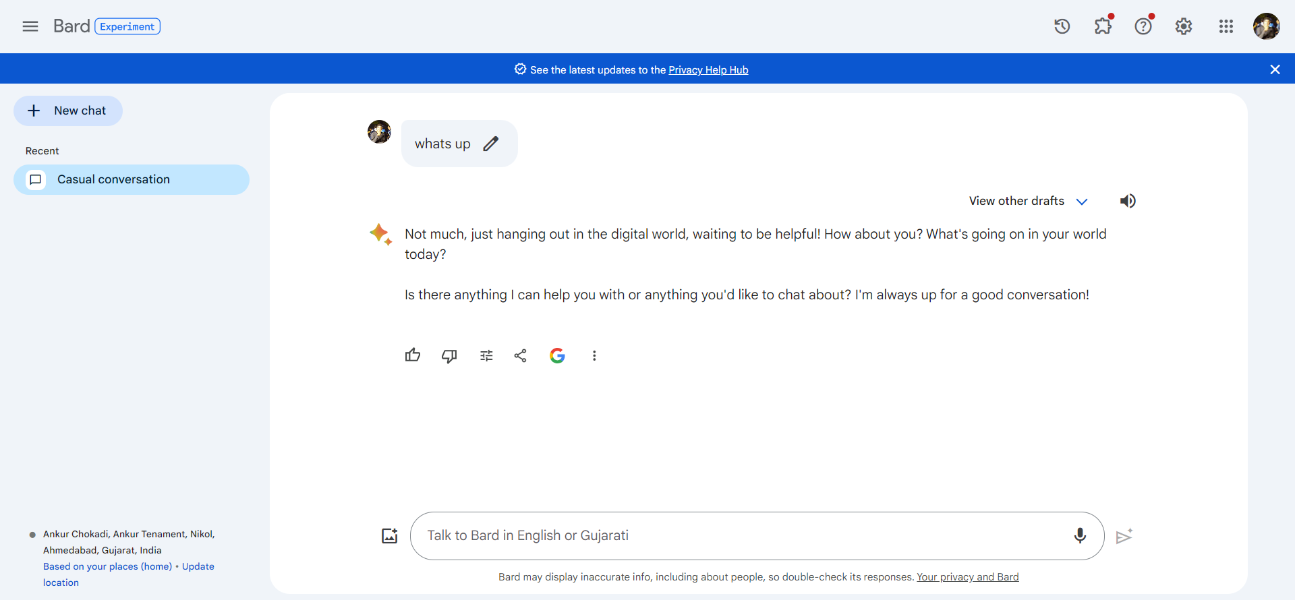
Figure: UI of Bard

Slide 12
How does it come in 3 sizes?
It is available in 3 sizes to scale it as per the need.
Or we can say to increase scalibility and accuracy.
Gemini Ultra:
The largest and most capable model, will be meant for highly complex tasks.
This model is still completing trust and safety checks, it is available now only to selected customers, developers, partners and safety and responsibility experts for early experimentation and feedbacks.
Gemini Pro:
It will be best at scaling across a wide range of tasks and is now available in bard for regular users across the world
On Bard, it has a “specifically tuned version of Gemini Pro in English for more advanced reasoning, planning, understanding and more”.
Gemini Nano:
Gemini Nano will manage on-device tasks (can be operated on mobile only).
Before December 13th, it was only available in Google Pixel 8 Pro.
But now, Android Developers will also be able to build with Gemini Nano via AICore, a new system capability available in android 14, starting on Pixel 8 Pro Devices.

Slide 13
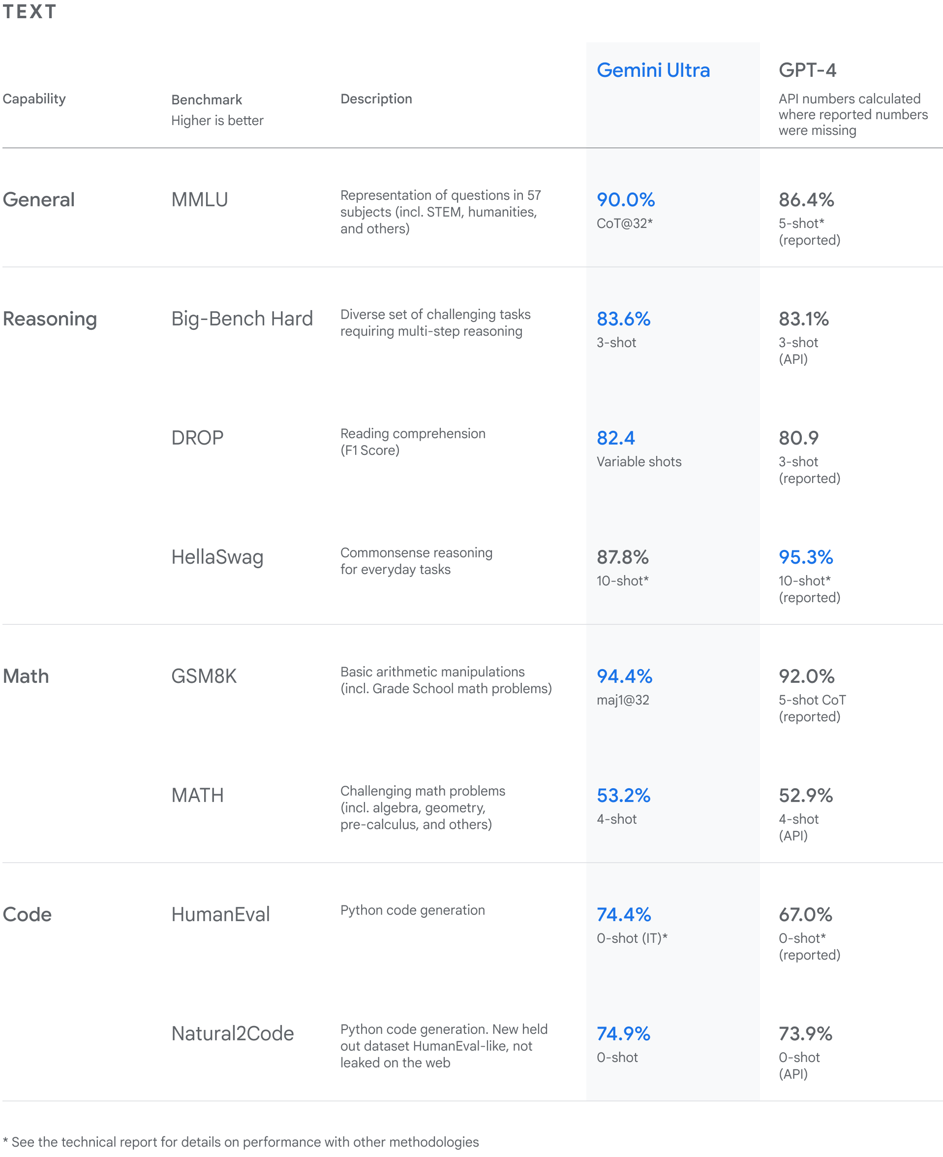
Accuracy of Gemini, compared to GPT-4. This figure contains the accuracy of Google Gemini compared to GPT-4 based on various benchmarks tested by LLMs. GPT scored more than Gemini in commonsense reasoning for everyday tasks.
[2]

Slide 14
Applications of LLM
04
Let’s discuss the applications of LLM

Slide 15
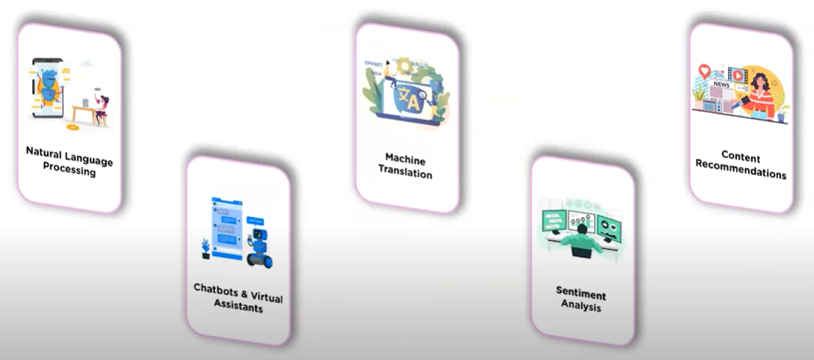
Applications of LLMs
[3]

Slide 16
05
Challenges
Let’s discuss about challenges of Gemini

Slide 17
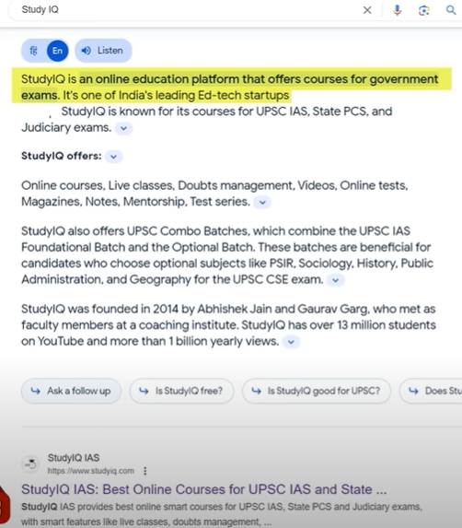
Challenges of Google Gemini
Google is still roll out to more products and services like Search, Ads, Chrome and Duet AI.
Google said it is already starting to experiment with Gemini in search “where it’s making Search Generative Experience (SGE) faster for users”
With a 40% reduction in latency in English in the U.S., alongside improvement in quality.
The company claims it has “most comprehensive safety evaluations of any Google AI model to date, including for bias and toxicity”.
[4]

Slide 18
Conclusion
06

Slide 19
Conclusion
Google Gemini is going to become new rival of ChatGPT. At the moment it is hard to say, but Gemini seems to be more flexible than GPT4 at the moment. Another factor is that Gemini is free to use while ChatGPT4 is only for paid users. Google Gemini is a powerful tool that has revolutionized the field of Data Science. Its unique features, ease of use, and integration with Google Bard make it a must-have tool for data scientists.

Slide 20
Resources
https://www.youtube.com/watch?v=sCd4oU7sqwA – Google Gemini
https://www.youtube.com/watch?v=_TVnM9dmUSk&pp=ygUNZ29vZ2xlIGdlbWluaQ%3D%3D – Gemini
https://www.youtube.com/watch?v=jV1vkHv4zq8&pp=ygUNZ29vZ2xlIGdlbWluaQ%3D%3D – Google’s newest and most capable
https://www.analyticsvidhya.com/blog/2023/12/what-is-google-gemini-features-usage-and-limitations/#:~:text=Conclusion,have%20tool%20for%20data%20scientists. [4]
https://spectrum.ieee.org/google-gemini - Gemini is Google’s Best AI Model Yet, But Who Cares?
https://www.analyticsvidhya.com/blog/2023/12/meet-gemini-googles-answer-to-chatgpt/ [2]

